Slide 1

Week-2
Introduction to Software Engineering
University Institute of Information Technology PMAS AAUR

Slide 2
Syllabus
Generic Process model
  Framework Activity,
  Task Set,
  Process Patterns
Process Assessment and Improvement
Perspective Process Models
  Waterfall Model,
  Incremental
  Process Model
  Evolutionary Process Model
University Institute of Information Technology PMAS AAUR

Slide 3
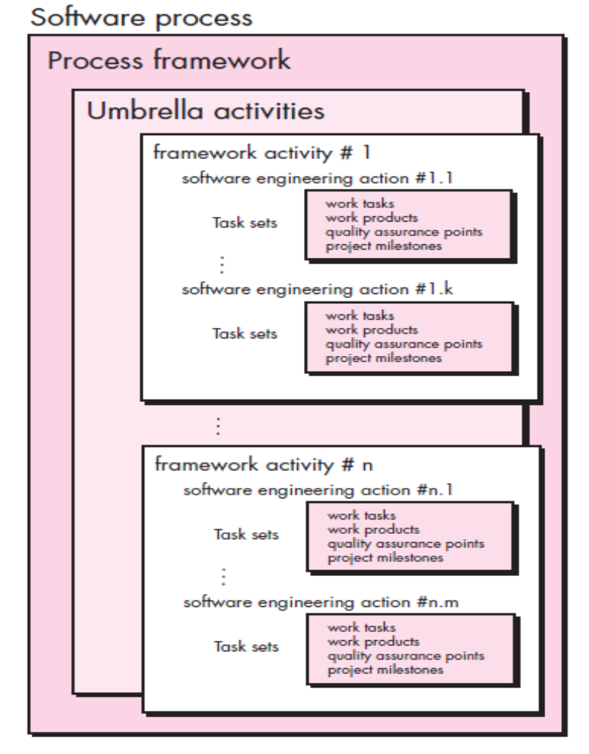
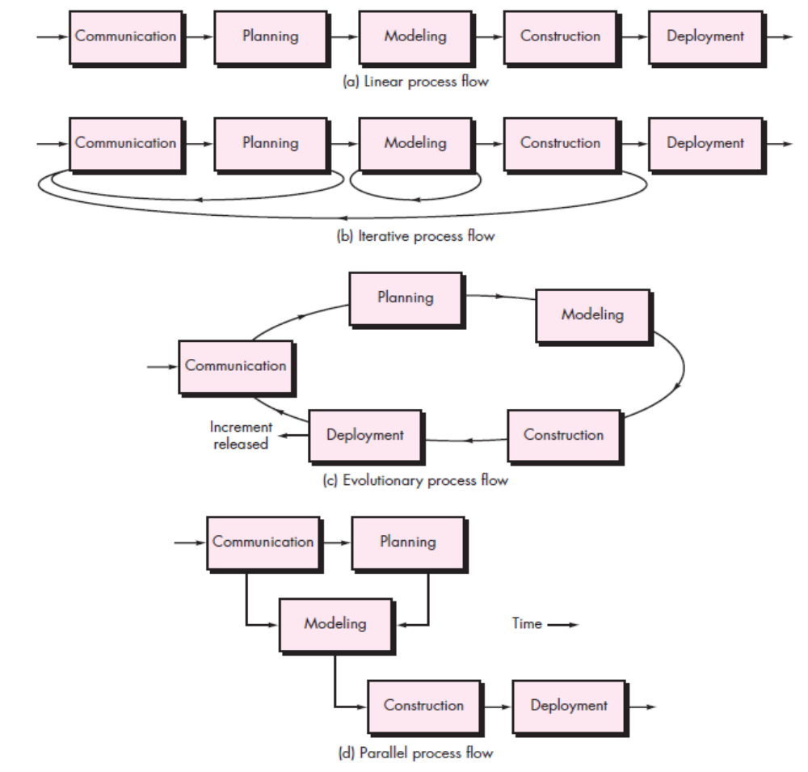
A GENERIC PROCESS MODEL
A software process framework
Process flow
University Institute of Information Technology PMAS AAUR

Slide 4
A GENERIC PROCESS MODEL
A generic process framework for software engineering defines five framework activities—communication, planning, modeling, construction, and deployment. In addition, a set of umbrella activities—project tracking and control, risk management, quality assurance, configuration management, technical reviews
Defining a Framework Activity
-What actions are appropriate for a framework activity, given the nature of the problem to be solved, the characteristics of the people doing the work, and the stakeholders who are sponsoring the project?
- action encompasses are:
1. Make contact with stakeholder via telephone.
2. Discuss requirements and take notes.
3. Organize notes into a brief written statement of requirements.
4. E-mail to stakeholder for review and approval.
Identifying a Task Set
- number of different task sets—each a collection of software engineering work tasks, related work products, quality assurance points, and project milestones
University Institute of Information Technology PMAS AAUR

Slide 5
Process Patterns A process pattern describes a process-related problem that is encountered during software engineering work, identifies the environment in which the problem has been encountered, and suggests one or more proven solutions to the problem.
Ambler has proposed a template for describing a process pattern:
Pattern Name
The pattern is given a meaningful name describing it within the context of the software process (e.g., TechnicalReviews).
Forces
The environment in which the pattern is encountered and the issues that make the problem visible and may affect its solution.
Type-three types:
Stage pattern—defines a problem associated with a framework activity for the process .
Task pattern—defines a problem associated with a software engineering action or work task and relevant to successful software engineering practice (e.g., R equirementsGathering is a task pattern).
Phase pattern—define the sequence of framework activities that occurs within the process.Ex: SpiralModel or Prototyping.
University Institute of Information Technology PMAS AAUR

Slide 6
PROCESS ASSESSMENT AND IMPROVEMENT
Standard CMMI Assessment Method for Process Improvement (SCAMPI)
- provides a five-step process assessment model that incorporates five phases: initiating, diagnosing, establishing, acting, and learning. The SCAMPI method uses the SEI CMMI as the basis for assessment.
CMM-Based Appraisal for Internal Process Improvement (CBA IPI)
- provides a diagnostic technique for assessing the relative maturity of a software organization; uses the SEI CMM as the basis for the assessment.
SPICE (ISO/IEC15504)
- a standard that defines a set of requirements for software process assessment. The intent of the standard is to assist organizations in developing an objective evaluation of the efficacy of any defined software process.
ISO 9001:2000 for Software
- a generic standard that applies to any organization that wants to improve the overall quality of the products, systems, or services that it provides
University Institute of Information Technology PMAS AAUR

Slide 7
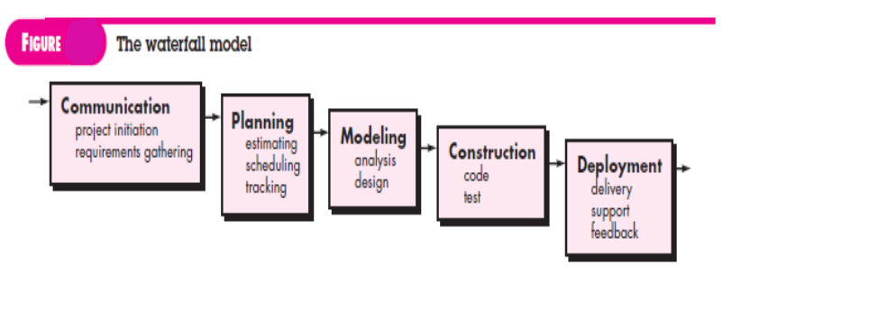
PRESCRIPTIVE PROCESS MODELS
1. The Waterfall Model
University Institute of Information Technology PMAS AAUR

Slide 8
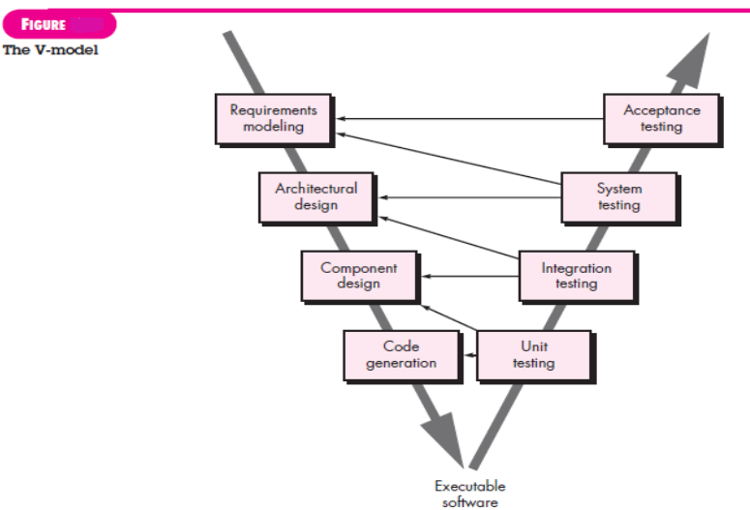
University Institute of Information Technology PMAS AAUR

Slide 9
The waterfall model, sometimes called the classic life cycle, suggests a systematic, sequential approach to software development that begins with customer specification of requirements and progresses through planning, modeling, construction, and deployment.
A variation in the representation of the waterfall model is called the V-model .
As a software team moves down the left side of the V, basic problem requirements are refined into progressively more detailed and technical representations of the problem and its solution.
oldest paradigm for software engineering.
serve as a useful process model in situations where requirements are fixed and work is to proceed to completion in a linear manner.
University Institute of Information Technology PMAS AAUR

Slide 10
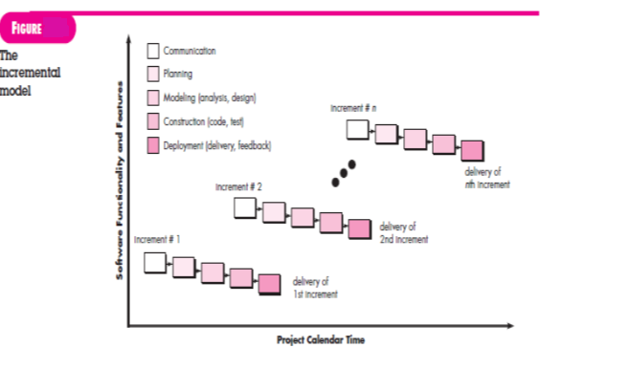
PRESCRIPTIVE PROCESS MODELS
2. Incremental Process Models
University Institute of Information Technology PMAS AAUR

Slide 11
The incremental model combines elements of linear and parallel process flows.
When an incremental model is used, the first increment is often a core product. That is, basic requirements are addressed but many supplementary features (some known, others unknown) remain undelivered.
The core product is used by the customer (or undergoes detailed evaluation). As a result of use and/or evaluation, a plan is developed for the next increment.
The plan addresses the modification of the core product to better meet the needs of the customer and the delivery of additional features and functionality.
This process is repeated following the delivery of each increment, until the complete product is produced.
focuses on the delivery of an operational product with each increment.
University Institute of Information Technology PMAS AAUR

Slide 12
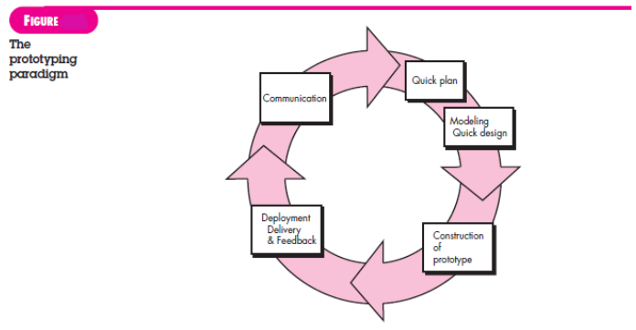
PRESCRIPTIVE PROCESS MODELS
Evolutionary Process Models
Prototyping
University Institute of Information Technology PMAS AAUR

Slide 13
The prototyping paradigm begins with communication.
You meet with other stakeholders to define the overall objectives for the software, identify whatever requirements are known, and outline areas where further definition is mandatory.
A prototyping iteration is planned quickly, and modeling (in the form of a “quick design”) occurs.
A quick design focuses on a representation of those aspects of the software that will be visible to end users (e.g., human interface layout or output display formats).
The quick design leads to the construction of a prototype.
The prototype is deployed and evaluated by stakeholders, who provide feedback that is used to further refine requirements .
prototype serves as a mechanism for identifying software requirements. If a working prototype is to be built, you can make use of existing program fragments or apply tools .
The prototype can serve as “the first system “
University Institute of Information Technology PMAS AAUR

Slide 14
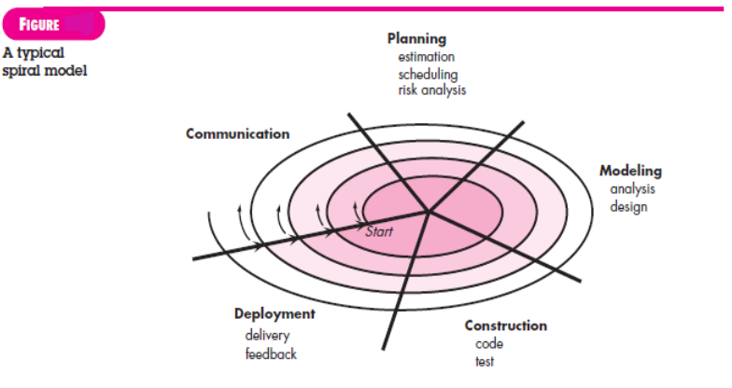
PRESCRIPTIVE PROCESS MODELS
II. The Spiral Model
University Institute of Information Technology PMAS AAUR

Slide 15
Originally proposed by Barry Boehm, the spiral model is an evolutionary software process model that couples the iterative nature of prototyping with the controlled and systematic aspects of the waterfall model.
It provides the potential for rapid development of increasingly more complete versions of the software.
risk-driven process model generator that is used to guide multi-stakeholder concurrent engineering of software intensive systems.
It has two main distinguishing features. One is a cyclic approach for incrementally growing a system’s degree of definition and implementation while decreasing its degree of risk .
Software is developed in a series of evolutionary releases. During early iterations, the release might be a model or prototype. During later iterations, increasingly more complete versions of the engineered system are produced.
divided into a set of framework activities defined by the software engineering team.
The spiral model is a realistic approach to the development of large-scale systems and software
University Institute of Information Technology PMAS AAUR

Slide 16
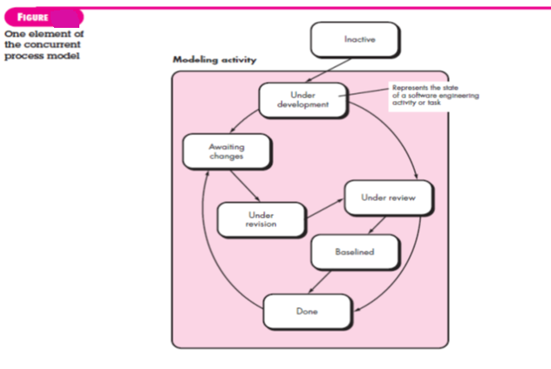
PRESCRIPTIVE PROCESS MODELS
4. Concurrent Models
University Institute of Information Technology PMAS AAUR

Slide 17
concurrent engineering, allows a software team to represent iterative and concurrent elements of any of the process models.
All software engineering activities exist concurrently but reside in different states.
Concurrent modeling defines a series of events that will trigger transitions from state to state for each of the software engineering activities, actions, or tasks .
Concurrent modeling is applicable to all types of software development and provides an accurate picture of the current state of a project.
University Institute of Information Technology PMAS AAUR

